Slide 1
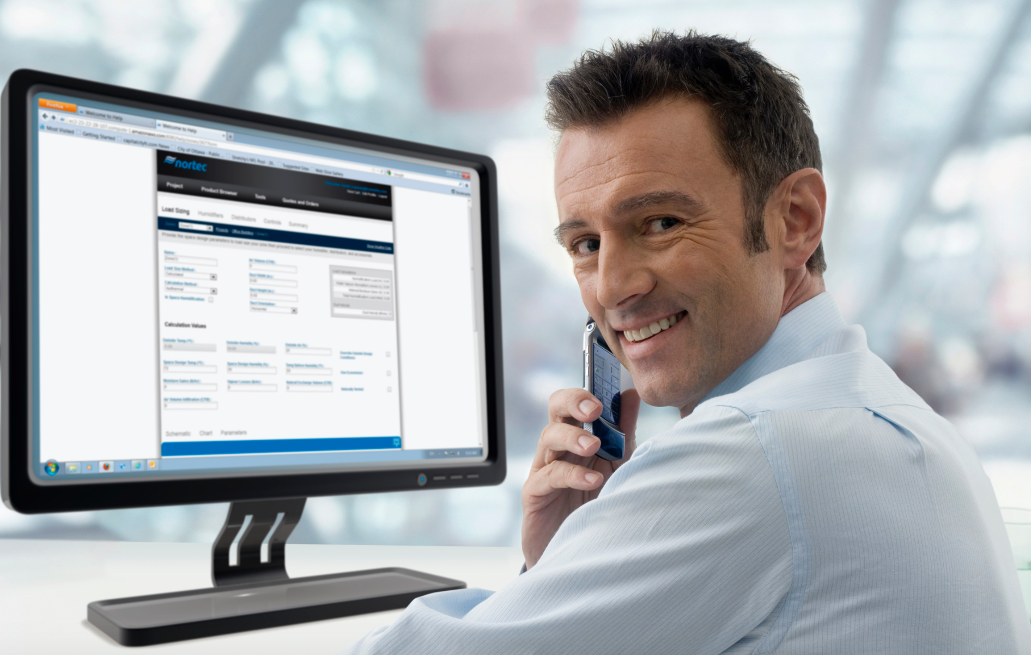
PeopleSoft ERP
FSCM 9.2 UPGRADE
Optum ERP Contracts Changes

Slide 2

Agenda
Introductions
Objectives
Schedule
Fit Gap
Business Process Deltas between 9.1 and 9.2
Online Review / Offline Review
Confirm new functionality that should be explored for system design
Workflow
If applicable – Confirm whether AWE or Virtual Approver will be used
Interfaces
Retrofit / Eliminate
Customizations
Retrofit / Eliminate
Reports
Retrofit / Eliminate
Security
Batch Schedule
Discussion

Slide 3
Objectives
Analyze the deltas between current Business processes and version 9.2.
Identify Gaps
Confirm Inventory of Interfaces, Customizations and Reports.
Facilitate the next stage – Upgrade A&D Project
A list of potential post upgrade improvements requiring new or changed configuration and business process that cannot be implemented now due to upgrade constraints.

Slide 4
Schedule
Date | Time | Topics
8/24/2016 | 9:00AM – 11:00AM | Business Modeling:- 9.2 Contracts Changes Session 1
8/25/2016 | 9:00AM – 1:00PM | Business Modeling:- 9.2 Contracts Changes Session 2

Slide 5

PeopleSoft 9.2 Global Enhancements

Slide 6
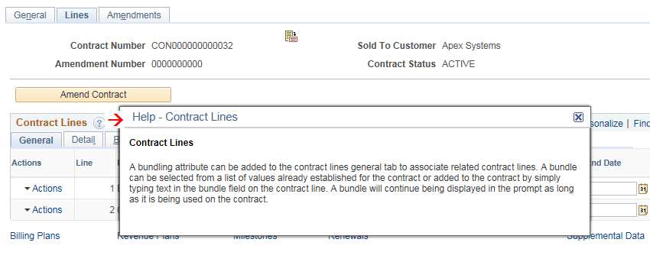
Embedded Help Overview
Select information icon on group boxes, grids, or scroll areas
Helps explain how to complete a specific task or transaction
Message appears in modal window that can be moved around page

Slide 7
Alignment, Order, and Positioning
Alignment
In PeopleSoft 9.1, all of the search and transaction fields were aligned to the left side of the page
In PeopleSoft 9.2, all of the search and transaction field labels will be right aligned to the fields
Order and Positioning
Order and position of fields on the page may have changed
Function is not impacted or changes as a result

Slide 8
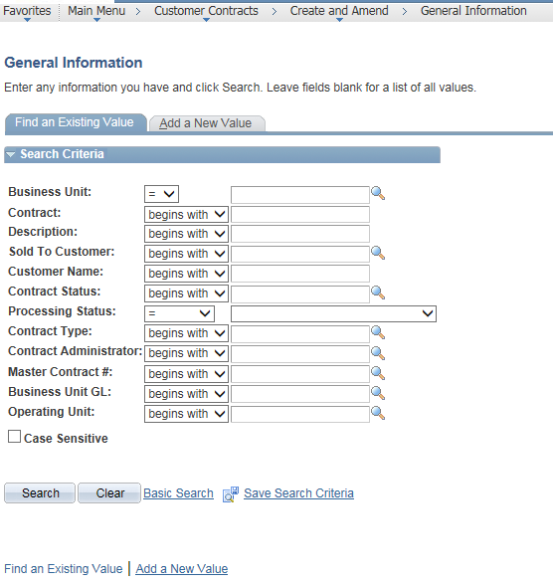
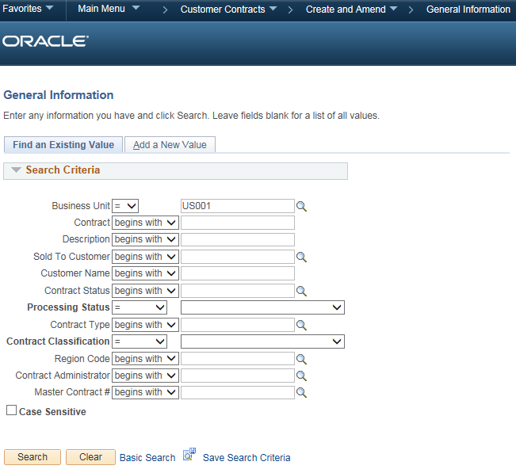
Alignment of fields in PeopleSoft 9.1 vs 9.2
PeopleSoft 9.1 | PeopleSoft 9.2

Slide 9
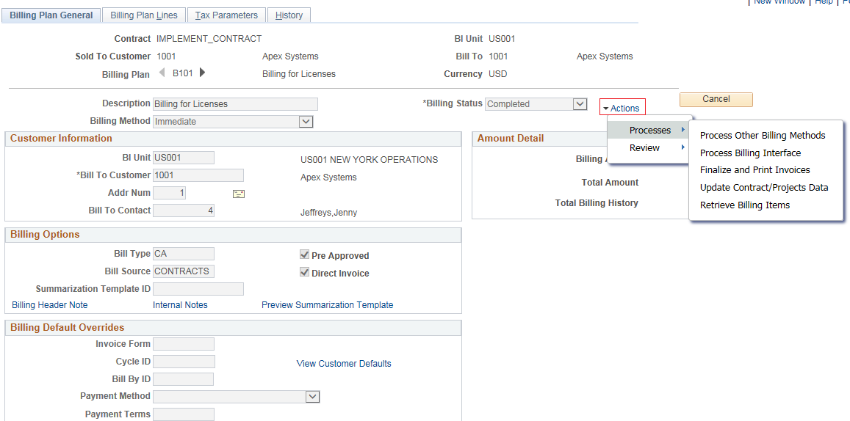
Related Action Framework

Slide 10
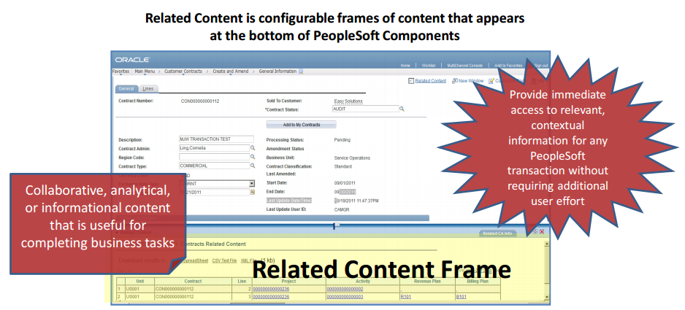
Related Content

Slide 11
PeopleSoft Contracts 9.2 Highlights

Slide 12
Contracts 9.2 Highlights
Separating Revenue Recognition from Billing in Contracts
Configurable Field Validation Framework for Run Controls
PeopleSoft Pivot Grid Overview
Modify Sold-to Customer on pending contracts
One access point to change the customer, address sequence number, and contact on all pending contracts
Reopen Completed Revenue and Billing Plan
Contract Activity Guide
Contract WorkCenter/Dashboards
Business Process Weaver
Supplemental Data
Data Migration Workbench
Contracts Workbench
Configurable work areas that help manage business processes and monitor exceptions such as keeping bill limits, posted revenue, and total award amounts in sync

Slide 13
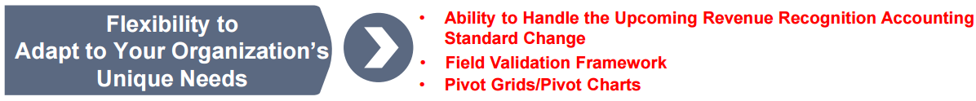

Slide 14


Slide 15
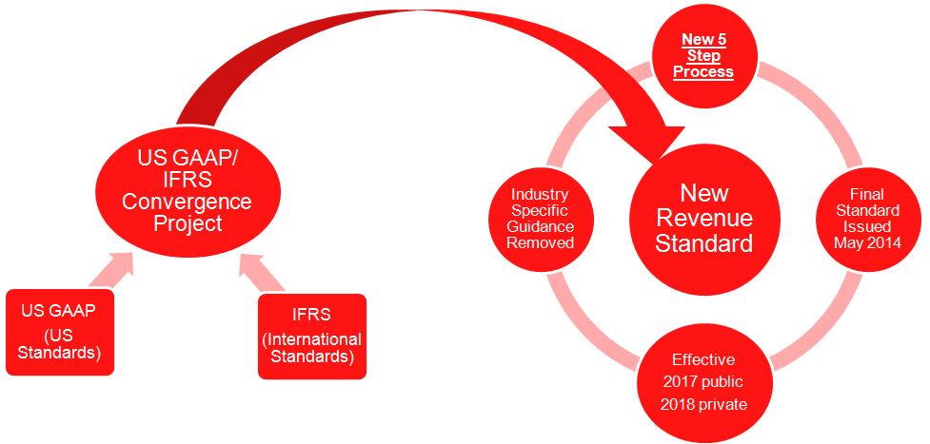
Functional Overview of the New Accounting Standard

Slide 16
Functional Overview of the New Accounting Standard – cont.
Current Generally Accepted Accounting Principles (GAAP) used in the United States are different from the International Financial Reporting Standards (IFRS) used in other countries
US GAAP/IFRS Convergence Project is sponsored by the FASB (The Financial Accounting Standards Board) which sets the accounting standards used in the United States and the IASB (The International Accounting Standards Board) which sets the reporting standards used by many other countries outside the US
Changes impact all public traded companies reporting to the Securities and Exchange Commission as well as other private entities that report financial results to others.
All entities that report revenue from customers that follow US GAAP are impacted by the change
Final standard was published in May 2014 with an effective date of 2017 for public companies

Slide 17
Supporting Transition to the New Revenue Accounting Standard
On amount-based contract lines, users can identify a revenue amount on the line that is different from the amount used for billing.
For rate-based contract lines, enhanced PeopleSoft Project Costing functionality allows separate calculations of revenue and billing based on cost, hours, or other input.
When creating a contract, users can opt to manage amounts and rates for revenue separately from those used for billing.
Alternatively, users can opt out of the new functionality, and amounts and rates used for billing will also be used for revenue.
New fields to capture the total contract price for billing and for revenue across all contract lines are included.
In the contract header, a new field, Contract Role, was introduced to be used to report revenue (and other financial metrics) as sales made directly to customers as a prime contractor or as sales made through intermediaries as a subcontractor.
New functionality included a new field on the contract line titled Bundle, which allows users to group related contract lines.
New functionality allowing separate configuration and processing of revenue and billing supports existing customer requirements and assists customers in their transition to the new revenue accounting standard

Slide 18
Recognizing Revenue Separate from Billing - Overview
Enhanced to allow customers the ability to define and manage revenue separate from amounts used to bill customers
One of the core concepts in the new revenue accounting standard is that individual contract line items be priced at amounts that reflect the value of the good or service being delivered to the customer
Price attributed to a contract line item for revenue recognition may be different than the price of the line item for billing
New fields were introduced to the contracts data structures allowing users to capture separate line level amounts for revenue, total revenue for the contract and total billing for the contract
‘Negotiated Amount’ in current 9.1 version has been renamed ‘Billing Amount’ and will be used for billing

Slide 19
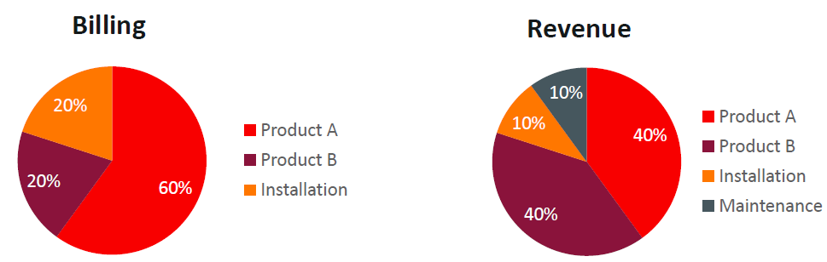
Separate Pricing for Billing and Revenue New Capabilities in Contracts and Project Costing

Slide 20
Separate Pricing for Billing and Revenue Contracts and Project Costing
Billing and revenue allocation
Identifying total contract price for billing and revenue
Separate structures for allocating billing and revenue to the contract line
Attributes for grouping/bundling contract lines
Revenue rate sets in project costing
Defaults to reduce decision making and user error
Able to be applied on existing contracts
Optional at the contract level

Slide 21
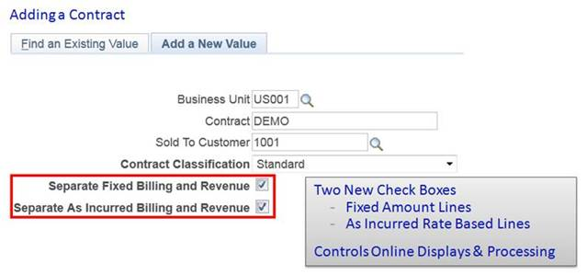
Separate Pricing for Billing and Revenue Adding a Contract

Slide 22
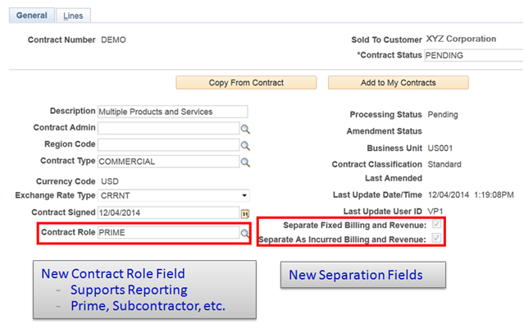
Separate Pricing for Billing and Revenue New Separation fields and Control Role field
A new field called Contract Role was added to the Contract General page to assist organizations with reporting
New revenue standard requires supplementary schedules to accompany the official financial reports including a schedule of disaggregated revenue
Specific categorization of disaggregated revenue is not mentioned in the standard, but should give users of the financial reports meaningful detail into the components of revenue.
One likely categorization of revenue is the amount of revenue recognized as a Prime Contractor verses the amount recognized as a Subcontractor.

Slide 23
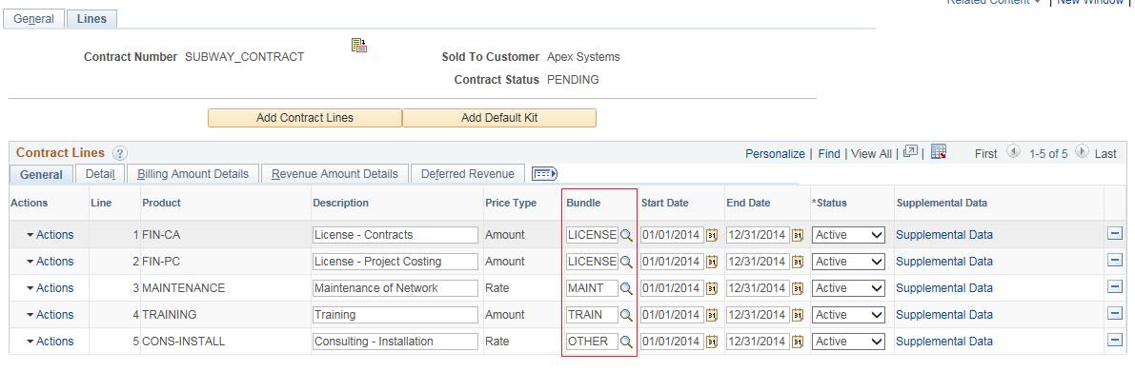
Separate Pricing for Billing and Revenue New Bundle field to Group related contract lines
A new field called Bundle was added to the contract line. This field should be used to group related contract lines into a ‘bundle’ for revenue recognition.
Bundle field allows organizations to associate related contract lines by assigning a common attribute to the lines.
The field can be used to group and sort contract lines on pages and as an attribute for reporting.
Detailed revenue recognition functionality will continue to exist at the contract line level and customers will have visibility into the summation of this detail via the bundle assigned to the contract line.

Slide 24
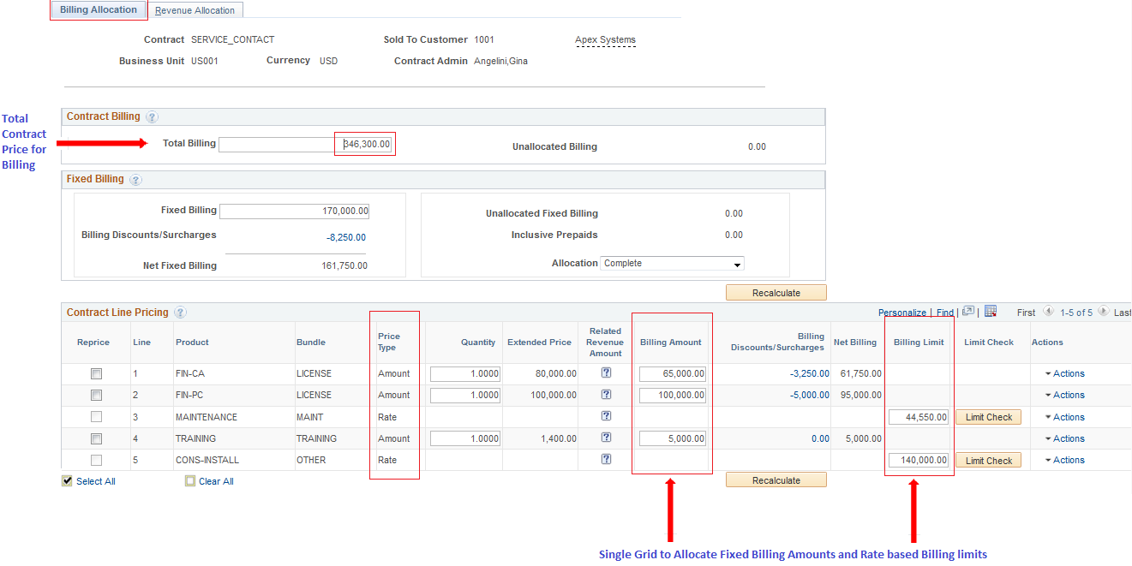
Separate Pricing for Billing and Revenue Billing Allocation

Slide 25
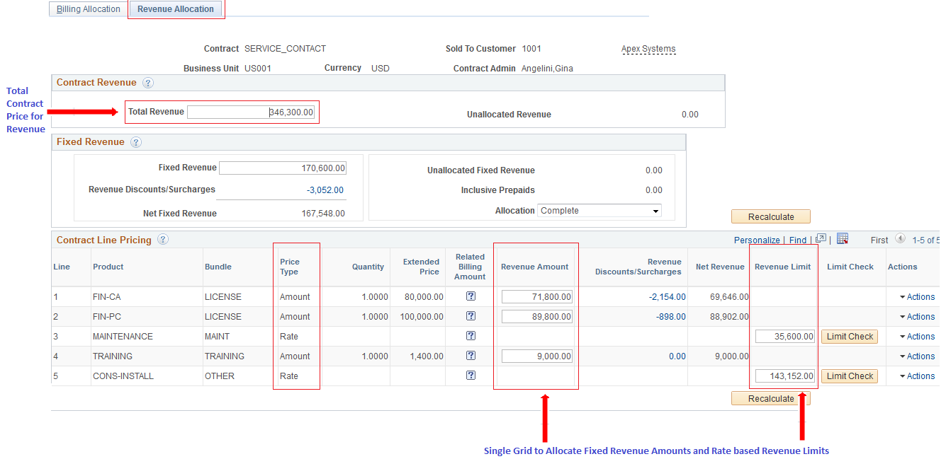
Separate Pricing for Billing and Revenue Revenue Allocation

Slide 26
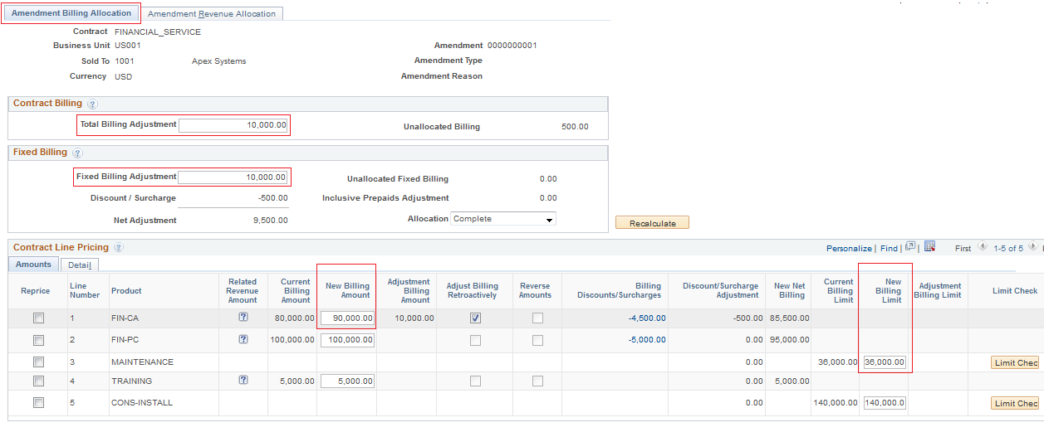
Separate Pricing for Billing and Revenue Amendment Billing Allocation

Slide 27
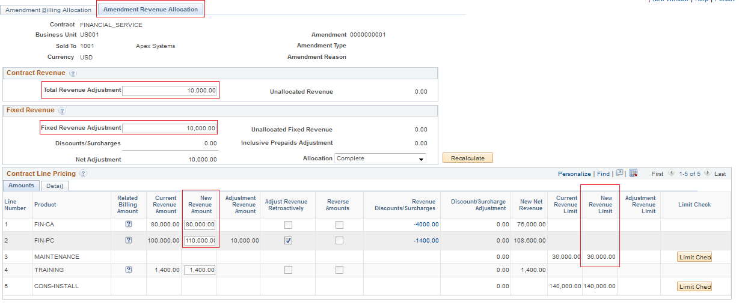
Separate Pricing for Billing and Revenue Amendment Revenue Allocation

Slide 28
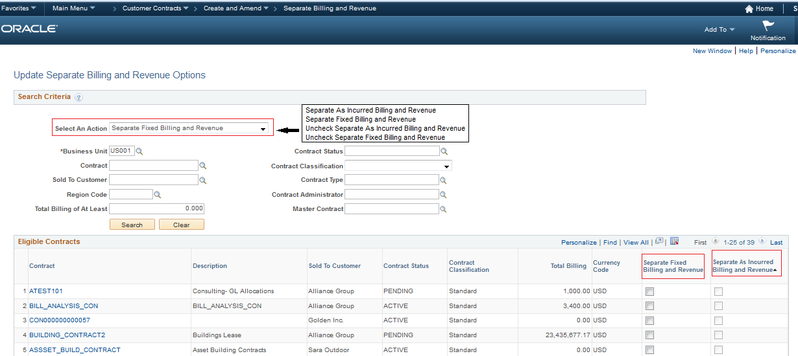
Update Separate Billing and Revenue Options

Slide 29
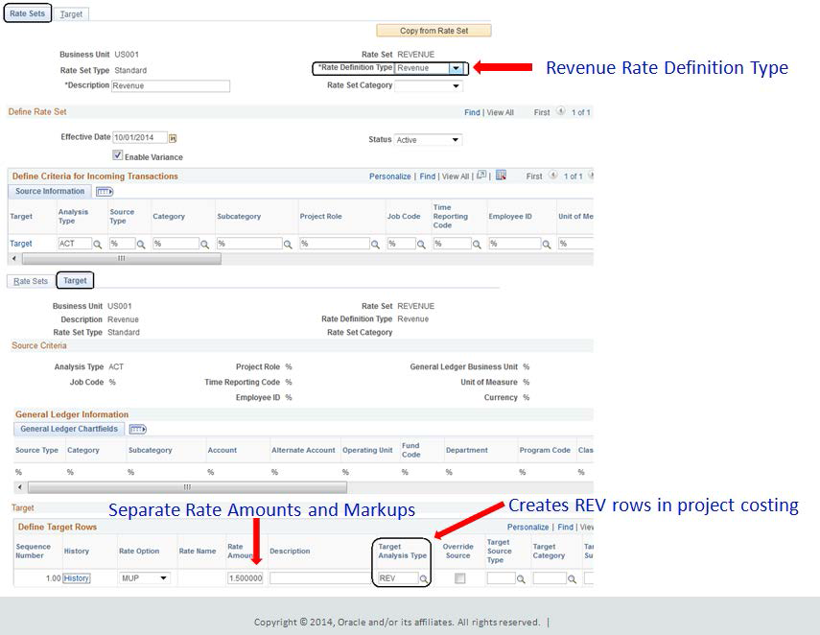
Separate Revenue Rate Sets for Rate Based Contract Lines

Slide 30
Separate REV and BIL rows
Eliminates the Do Not Process Revenue Customization in the Billing Rule
On contracts that separate as incurred billing and revenue, Pricing process generates REV rows for revenue recognition along with BIL rows which represents only billing
In contrast, contracts that do not separate billing and revenue will only create BIL analysis types and they will be used for both billing and revenue recognition.
DEMO

Slide 31
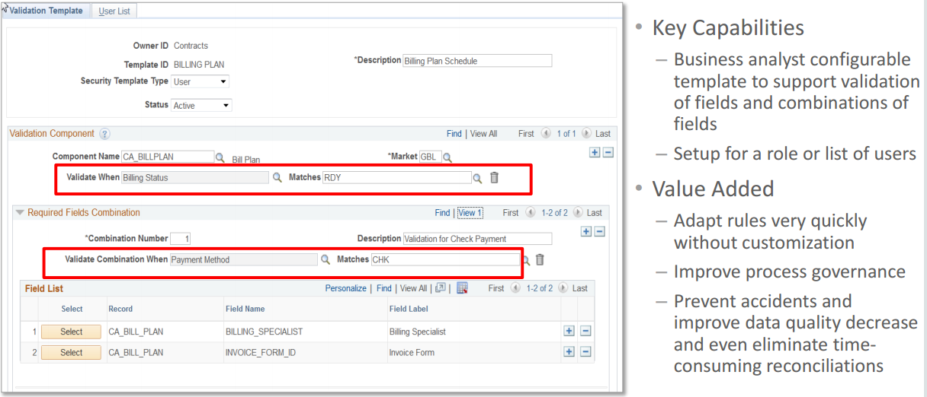
Configurable Field Validation Framework for Run Controls
Specify the combinations of fields on various Contracts Run Control components that must contain values when a user tries to run a process
Set up templates to specify, either by role or set of users, which fields are required when a user attempts to launch a process
Enables organizations to ensure that the necessary validations configured by the users are enforced, thus narrowing the scope of transactions end users can affect when they run a process
Provides greater control on the run control parameters that could be passed as inputs to the key processes

Slide 32
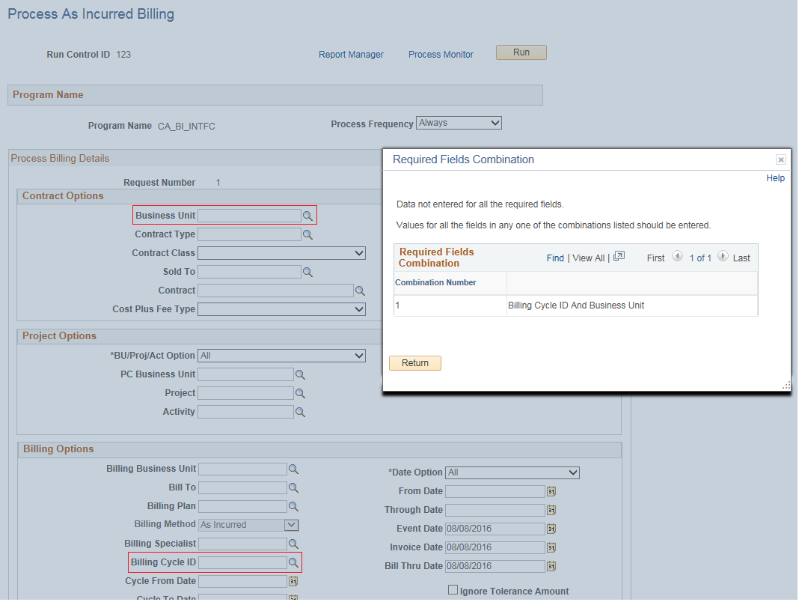
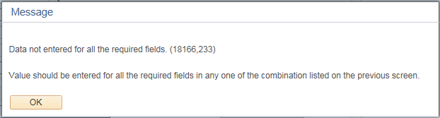
Validation Template – Error Message

Slide 33
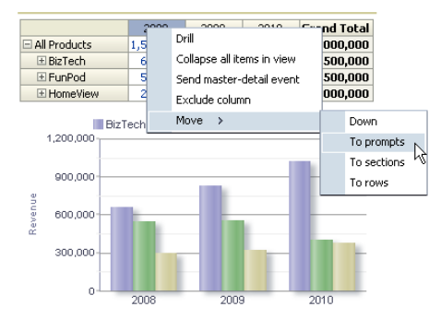
PeopleSoft Pivot Grid Overview
Advanced reporting technology
Provides interactive, analytical grids and charts
Similar to Pivot Tables in Excel
Performs pivoting and filtering operations
Uses data sources like PeopleSoft Query
Chart and grid are synchronized
View data in 3 different visualizations:
Grid only
Chart only
Grid and chart

Slide 34
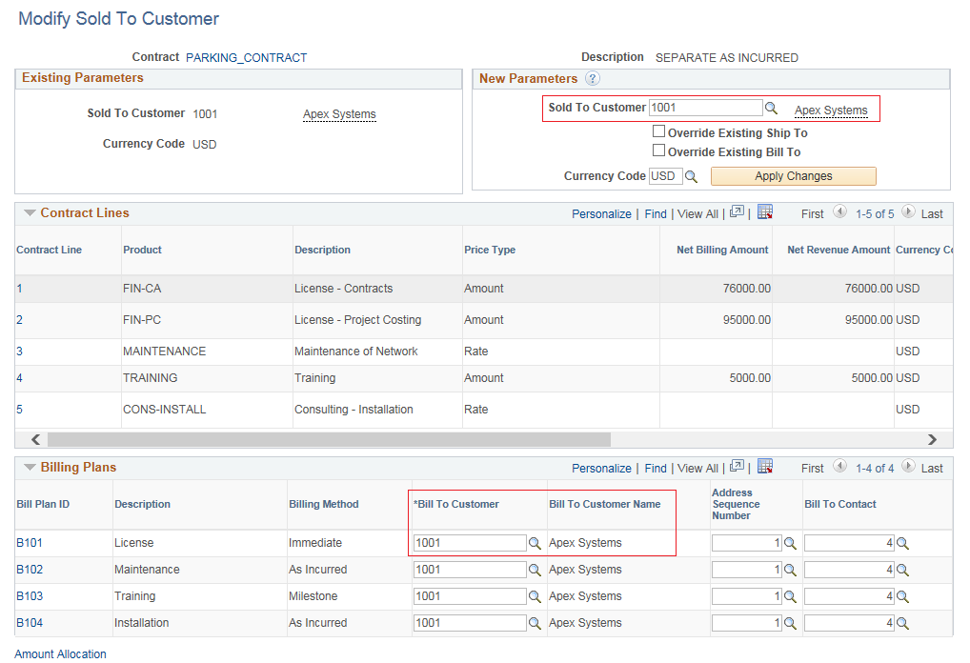
Modify Sold to Customer on Pending Contracts
Modified Sold to Customer Page provides an editable Sold to Customer Field
Users will be able to change the Sold To Customer on pending contracts. This flexibility eliminates the re-keying of data that is typically required in situations when business needs dictate that the customer associated with a pending contract needs to change.

Slide 35
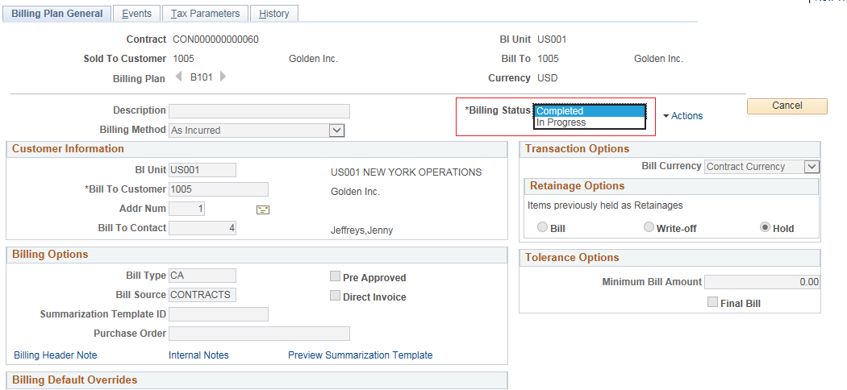
Reopen Completed Billing and Revenue Plans
Users can now reopen bill plans and revenue plans, associated to rate based contract lines, after they have been marked as completed as long as the customer contract still has a status of active.
Offers option to bill and recognize revenue easily for project transactions that arrived late
This new flexibility removes the need to account for and track the late transactions as reconciliation exceptions and, more importantly, can help to minimize the number of billable but late project costs that an organization is forced to write off.

Slide 36
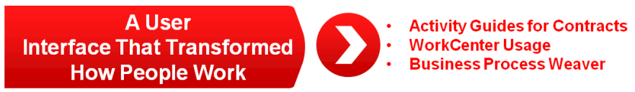

Slide 37
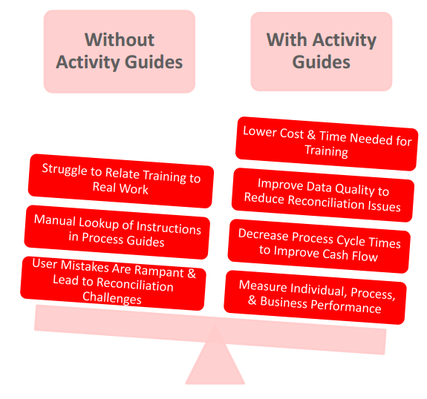
Activity Guides (aka Train Stops) Implementing, Teaching, and Institutionalizing Complex Business Processes
Activity Guides allow application designers to define processes that guide users through a series of predefined actions to complete a transaction / Process.
Users are presented with a list of actions on their screen which need to be completed to finish a transaction/Process
The configuration allows you to specify which steps are optional and which ones are required
You can even launch workflow and approval routing as part of your processing steps
Activity guides are very different from workflow.
Activity Guides – Perform Transactions
Workflows – Approve or Deny

Slide 38
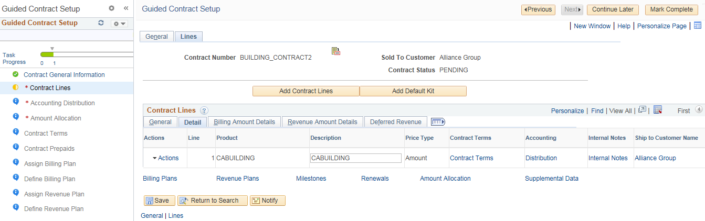
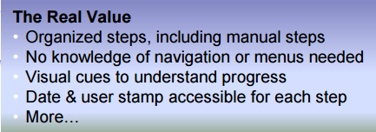
Contracts Activity Guide
Provides a list of sequential tasks or action items that need to be completed by the user to make a contract active
Eases the user experience of creating a contract and performing associated activities
Reduce not only the errors that affect billing and revenue recognition, but also the time required for new employees to become productive.
There can be a train stop for each step of the process. This allows the user to know exactly where they are in the process and what comes next.

Slide 39
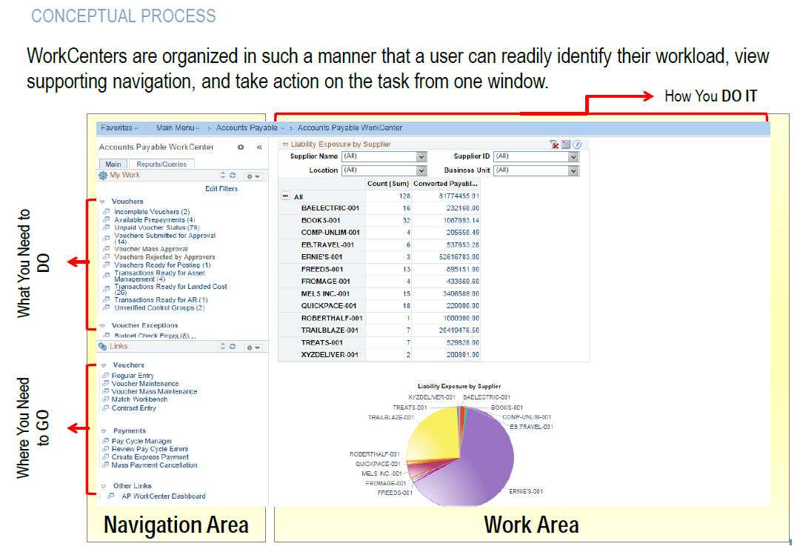
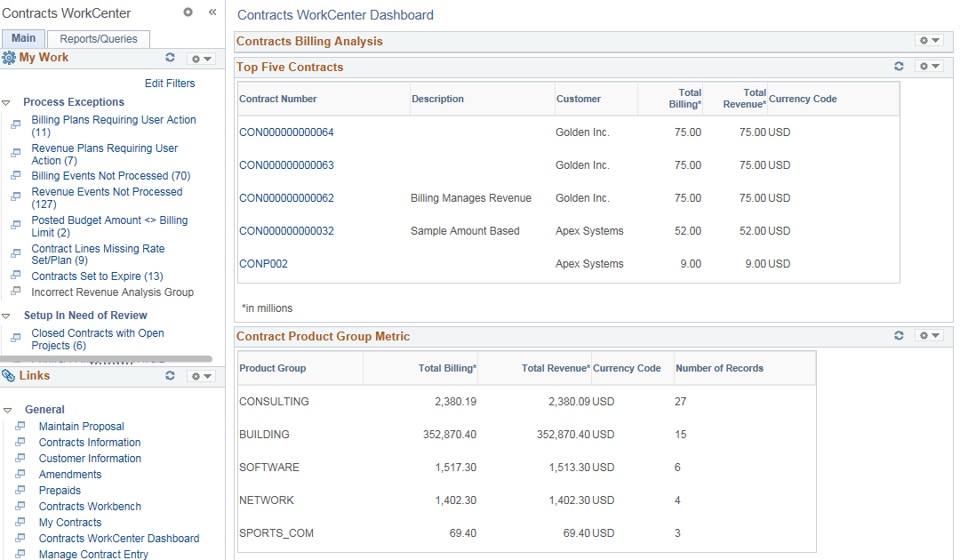
WorkCenters

Slide 40
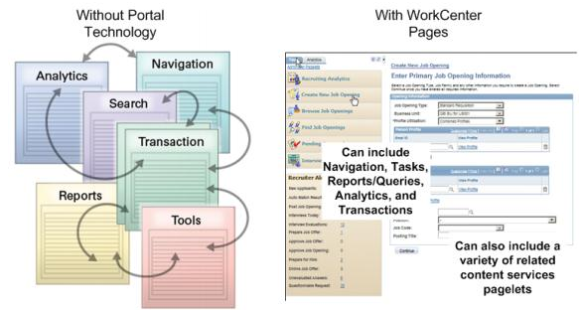
WorkCenters – Overview
Central place for users to do their day-to-day work
Reduce the amount of Navigation time and increase productivity
WorkCenters include links to:
Transaction and Inquiry Pages
Queries
Analytic pagelets / Pivot Grids
External Pages and applications (exp. other Systems)
Ability to create your own custom dashboards using empty dashboard shells

Slide 41
Contracts WorkCenter
Helps users to quickly identify and resolve key process exceptions so that contracts proceed unimpeded. Key components of the Contracts WorkCenter include:
The Dashboard – a graphical display of real-time financial information related to the specific module. There is a default dashboard for each WorkCenter; you can modify the default display to suit your needs and preferences.
The My Work section – lists of current things for you to take action on. These lists may be called Current Work or Alerts. For example, perhaps you have journals that are ready for processing, or worksheets to be posted.
The Links section – a collection of pre-built “favorites” that let you navigate quickly to the update/inquiry transactions you need for common tasks. For example, you have a link to the Create/Update Journals transaction and to the Copy Journals transaction in the General Ledger WorkCenter.
The Reports/Queries section – a separate tab that gives you access to relevant PeopleSoft-delivered reports and public queries, as well as to processes. For example, you can quickly run a journal entry print report.
DEMO

Slide 42
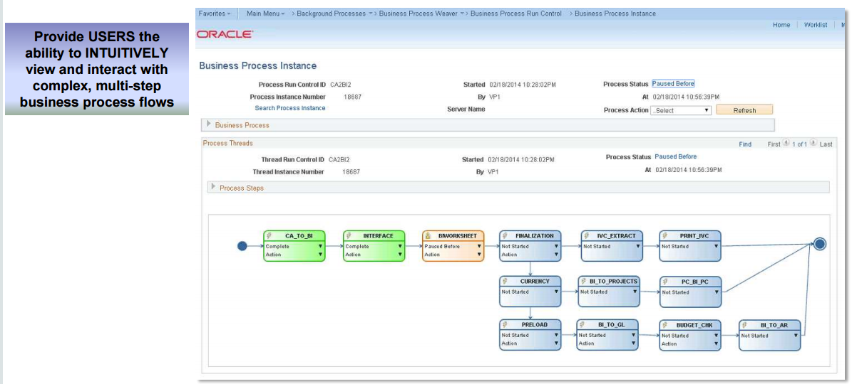
Visualize and Orchestrate Contract to Cash with Business Process Weaver
Comprehensive contracts to cash business flow enabled by the Business Process Waiver.
With this configured process, a billing specialist, for example, will be able to initiate the entire process starting from the Contracts - Billing Interface and ending with final posting steps in Billing, Receivables, General Ledger, and Project Costing.
Billing Specialists will be able to run the Contracts to Billing Interface Process via Business Process Weaver, which automatically initiates all of the necessary downstream processes.

Slide 43
Business Processes – Deltas 9.1 vs 9.2 Supplemental Data
Ability to configure new fields with custom labels and sections on the Contract General pages for tracking key contract information to meet reporting and compliance requirements
Ability to add Contract Attributes without any additional customization effort.
Provides a way to define additional contract data at the header and line level

Slide 44
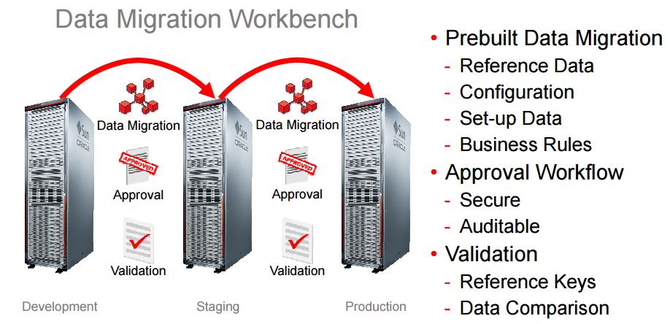
Data Migration Workbench

Slide 45
Data Migration Workbench for Contracts data
Compare, validate, and copy application configuration data between databases
Application Data Sets (ADS)
Alternative to Data Mover scripts
Greater visibility and control of managed changes
PeopleSoft Pure Internet Architecture (PIA)
Similar to copy and compare process of managed objects
New functionality for applications:
Allocations
WorkCenters
Accounting Rules

Slide 46
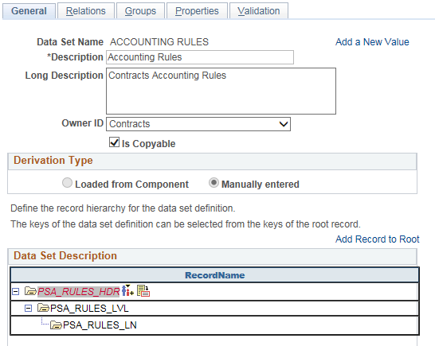
Contracts – Accounting Rules
Accounting Rules are used to generate billing and revenue accounting entries. You can create and test Accounting Rules in a test databases, and use ADS definitions to move them to other databases or to the production database when finalized.

Slide 47
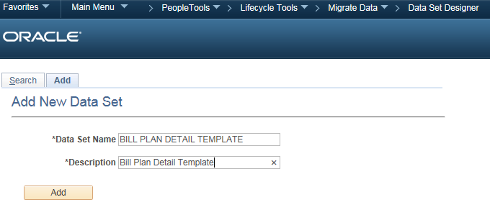
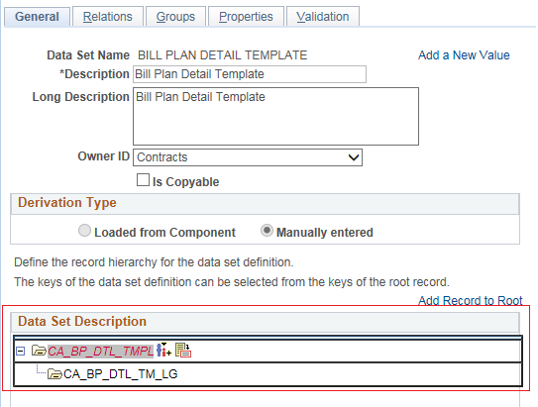
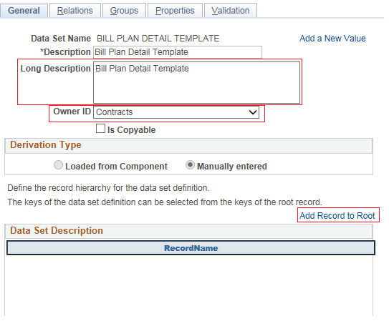
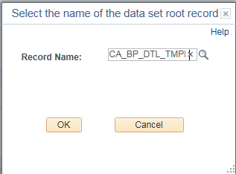
Setting up Data Migration Workbench – Create Data Set

Slide 48
Customizations
Customizations | Description | Carry forward
Contract Workflow | Workflow functionality will allow contracts to go through two steps - fulfillment review and finance review during Contract creation, amendment and Renewal process | Retrofit
Contract Page Customizations | Contract Additional Header and line level fields added for reporting purpose Hold Reason Code in Bill Plan and Revenue Plan | Retrofit/Eliminate using Supplemental data?
Contract Hold on Credit Check | Bill plan and Revenue plan on hold when the customer outstanding is overdue | Retrofit
Revenue and Billing Amount allocation to contract line | Capture Billing Product ID, Billing Product Description, Billing Product Group Key field in the Contract Line, Capture Revenue Product ID information in the Accounting Distribution | Eliminate Separate Pricing for Billing and Revenue in 9.2
Contract Revenue Forecast by Customer | Ability to forecast services revenue by Customer | Retrofit/Eliminate?
Contract Audit | Ability to audit the billing plan/schedule changes, update the user id and name of the user who updated revenue accounting distributions, audit the changes done to contract and project milestones, Maintain audit trail of who placed a bill plan on hold and who released it with date time stamp, audit the revenue transactions and maintain audit trail for SOX 404 reporting | Retrofit
Sales Order Creation | In Contract creation (or) amendment (or) renewal, PeopleSoft Contracts should have the ability to automatically create Sales Order in Order Management when the fulfillment reviewer reviews the contract and changes the contract status to financial review. The PO number/identifier should be passed on to Order Management while creating the sales order. | Retrofit/Eliminate?

Slide 49
Customizations
Customizations | Description | Carry forward
GL Distribution | Distribution Setup Distribution Code setup with UAR and AR Distribution Distribution code defaults for fixed price deals Distribution code defaults for rate based (transactions) deals Invoice accounting Distribution code defaults for rate based (projects) deals Invoice accounting – UAR and AR ChartField updates Sales tax accounting entry Elimination accounting entries and Legal Entity and Inter/Intra Unit flags defaulting Revenue accounting entries Project Costing revenue accounting entry TBP accounting revenue entry AR accounting Bad Debts and Write off accounting | Retrofit
Auto Renewal Functionality | Auto Renew functionality in PS is currently limited to Amount based products. Need to move that functionality to rate based products. | Retrofit
Contract Cancellation | Ability for super user to cancel a contract mid-workflow if critical data is in error (e.g. Sold To Customer) | Retrofit/Eliminate?
Contract PO Tracking | Allow users to capture the limit of a purchase order and expiration dates. Further it will stop the billing and revenue activities if purchase order limit is stopped Not currently used in production | Eliminate?

Slide 50
Customizations
Customizations | Description | Carry forward
TBP Pricing Rule | Maintain Flat, Band, tiered and volume based price types Hold the pricing model setup for usage and master which will be maintained by business Allow the users to manually review/update transactional data before sending to billing | Retrofit
PeopleSoft search screens changes | GL BU, OU and GL Strings in PeopleSoft search screens | Retrofit
Data Separation Contracts Changes | Product LoB will be added to the Product search page to add Contract line Contract Lines grid will have the Product LoB Billing data will be separated in Contracts to different Billing processing business unit based on the products line of business. Product LoB mapping changes | Eliminate?
Correct initial Upside contract id | Ability for super users to correct initial Upside contract id | Retrofit?
Manual Application of Credit amendment to Contract | Currently within [ERP] no capability exists for users to determine how to apply credit across specific events. [ERP] employs a systematic process for credit application that cannot be adjusted by end users. [ERP] will not allow negative amendments to process without utilizing the systemic process. Provide ability for users to Modify the existing event detail lines for a credit amendment. Add a new row and event to the event detail lines in order to process the entire credit amendment as a new invoice. | Retrofit

Slide 51
Customizations
Customizations | Description | Carry forward
Invoice Footing | Quantity and Rate should be entered by the user in the Bill Plan event page to be carried over to billing for printing it in Invoice Amount should be not calculated automatically based on Quantity * Rate and this field should be not editable Amendment Quantity and Amendment Rate should be entered by the user in the Bill Plan event page and Amendment Amount should be calculated | Retrofit
Products not requiring Fulfillment Review | Every product does not require a fulfillment review e.g. Travel Expenses. Only products that require a fulfillment review by Optum Order Fulfillment staff are included in the fulfillment review workflow in [ERP]. | Retrofit
Contract Classification selection | Default Contract Classification to Standard and make classification field read-only | Retrofit
Contract Bill Plan event workflow | If any of the bill plan event status is changed, Internal notes hyperlink should be display to capture the justification | Retrofit
MileStone Date logic changes | If the Contract milestone is not completed, rest of the date events in the Billing Plan should not send to Billing interface even it satisfies the date conditions Revenue Plan should not create Revenue accounting entries even it satisfies the date conditions If the Contract milestone is completed, Milestone Update process should be run which will update the rest of the date events in the Billing plan monthly (or) quarterly from the Milestone completion date based on the prior event schedule Revenue plan monthly (or) quarterly from the Milestone completion date based on the prior event schedule | Retrofit

Slide 52
Customizations
Customizations | Description | Carry forward
Modify Ship to Address details | Allow users to modify Ship to Address Seq number and Primary Contact ID | Retrofit
Contract Bill Plan Event Note Changes | Bill Plan Event Notes hyperlink should be moved our of grid and display below to allow user to enter multiple motes | Retrofit
Contract CPI Changes | Identify contracts containing annual [Consumer Price Index] (CPI) increases Systematically apply the annual [Consumer Price Index] (CPI) increase in [ERP] Produce reports for Lynx users, Financial Operations Team, controllers, etc. on [Consumer Price Index] (CPI) increases | Retrofit

Slide 53
Inbound Interfaces
Interface | Description | Carry forward
Opportunity Integration with Salesforce | Contracts(Create/Amend/Renew)
TBP File inbound to PS | TBP file processing from Product system
TBP for ALIFE | TBP Mapping logic in ERP
Upside Contract Documents | Integrate with Upside/Contract Hub for receiving Contractual documents

Slide 54
Outbound Interfaces
Interface | Description | Carry forward
Outbound integration to Salesforce | Order status update(BOOKED) to Salesforce
 | Product Fulfillment outbound from PS

Slide 55
Custom Reports
Report Name | Tools | Carry Forward?
 | Query | Carry Forward

Slide 56
Security
Security | Description | Carry forward

Slide 57
Batch Schedule
Batch Schedule | Description | Carry forward

Slide 58
Thank you
Contact information
Shan Kuthalingam
#952-945-6770
Shan_kuthalingam@optum.com

Slide 59
Business Processes – Deltas 9.1 vs 9.2
Supplemental Data (Continued) - Define a supplemental data record

Slide 60
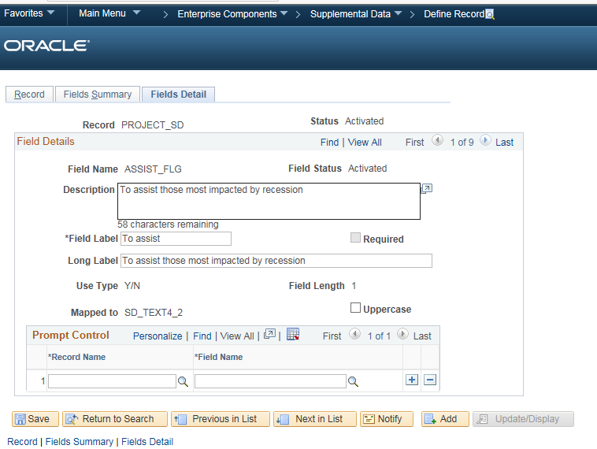
Business Processes – Deltas 9.1 vs 9.2
Supplemental Data (Continued) - Specify details for supplemental data record files

Slide 61
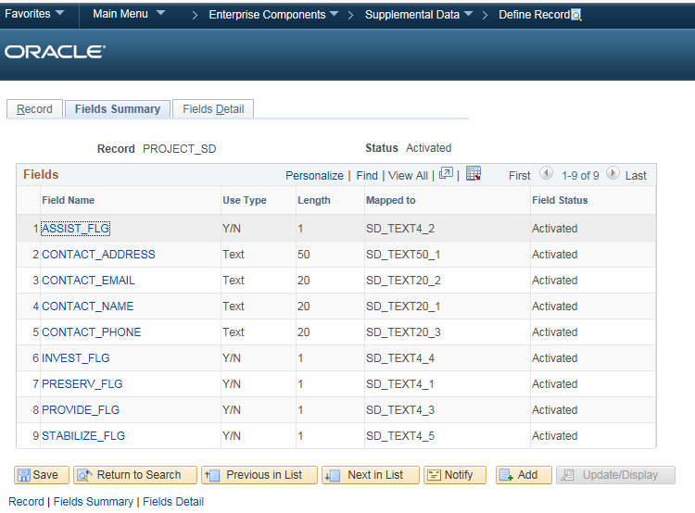
Business Processes – Deltas 9.1 vs 9.2
Supplemental Data (Continued) - Define and map supplemental data record fields to data store records

Slide 62
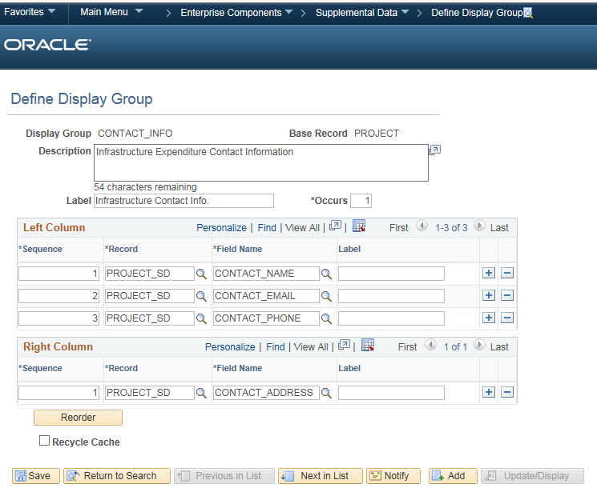
Business Processes – Deltas 9.1 vs 9.2
Supplemental Data (Continued) - Define a supplemental data display group

Slide 63
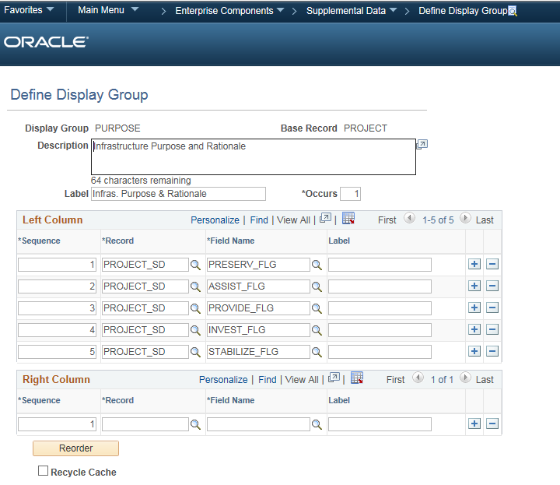
Business Processes – Deltas 9.1 vs 9.2
Supplemental Data (Continued) - Define a supplemental data display group

Slide 64
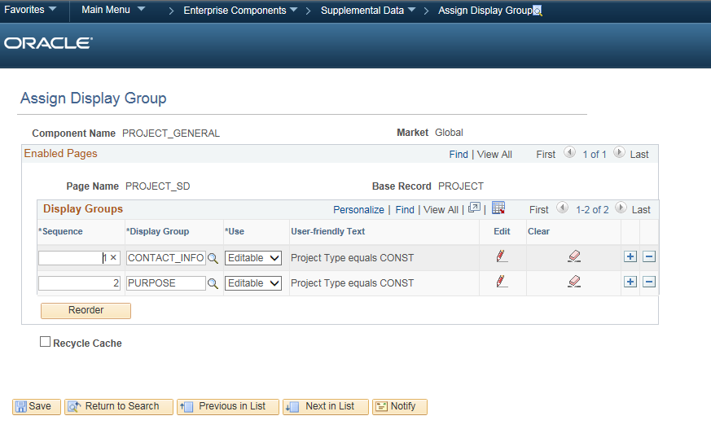
Business Processes – Deltas 9.1 vs 9.2
Supplemental Data (Continued) - Assign a supplemental data display group

Slide 65
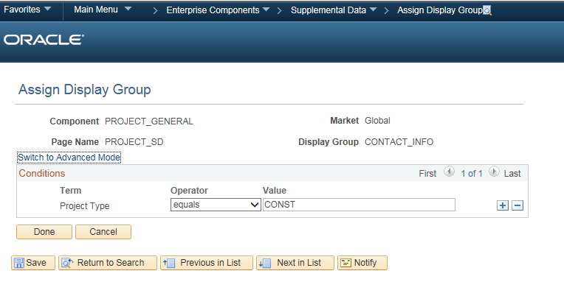
Business Processes – Deltas 9.1 vs 9.2
Supplemental Data (Continued) - Define conditions for display groups

Slide 66
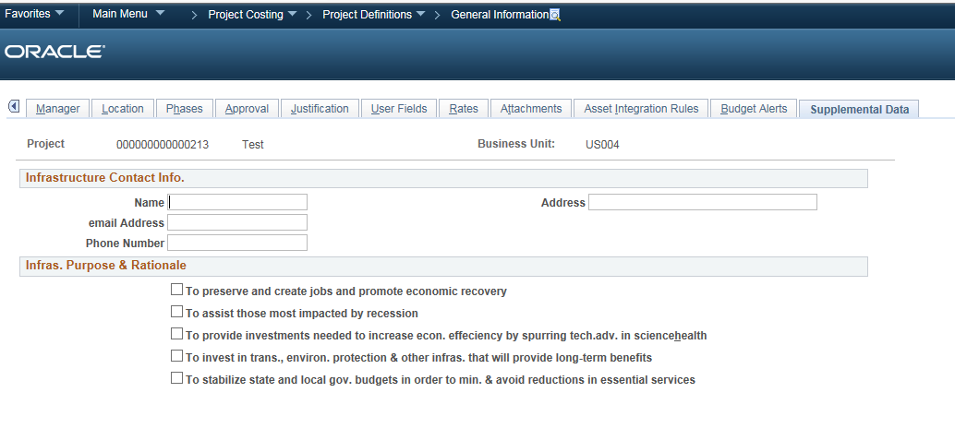
Business Processes – Deltas 9.1 vs 9.2
Supplemental Data (Continued) – Project General information

